Slide 1
Eksplorasi WSO2 BPS dan JBPM
Kelompok Alfresco
13509085 - Andre Novelando
13511026 – Akbar Juang Saputra
13512030 – Alvin Natawiguna
18211031 – Nicolas Novian Ruslim
13511078 – Taufik Hidayat

Slide 2
WSO2 BPS
WSO2 Business Process Server (BPS) is an easy-to-use Business Process Server that executes business processes written following WS-BPEL standard.
WS-BPEL is emerging as the de facto standard for composing multiple synchronous and asynchronous web services into collaborative and transactional process flows which increase the flexibility and agility of your service-oriented architecture.

Slide 3
WSO2 BPS
WSO2 BPS is powered by Apache ODE (Apache Orchestration Director Engine).
WSO2 BPS provides a complete Web-based graphical console to deploy, manage and monitor business process and process instances.

Slide 4
WSO2 BPS Features
Define and Execute Business Processes
Data Manipulation & Extensibility
Define Workflows Interacting with People
Create & Monitor Custom Key Performance Indicators (KPIs)
Graphical Process Modeling
Process Management via Graphical Administration Console
Integrates to Existing Environment
High Availability, Scalability and Stability
Lightweight, Developer Friendly and Easy to Deploy
Manage & Monitor

Slide 5
JBoss jBPM
JBoss jBPM is a workflow, process automation, that enables coordination between disparate applications and services, resulting in the deployment of new revenue generating business processes

Slide 6
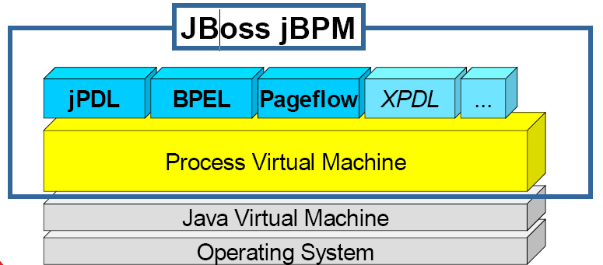
Architecture Jboss jBPM
JBoss Enterprise Framework that delivers workflow, business process management (BPM) and service orchestration in a multi-process language platform and in a scalable and flexible product footprint.

Slide 7
References
www.egjug.org/files/Introducing%20JBPM.ppt
http://wso2.com/products/business-process-server/
http://www.jbpm.org/

